Slide 1
License Management Tool (LMT)
Location: Timisoara, 22.06.2020
Uicoaba Alexandru & Cabau Sorin Adrian Vitesco Technologies

Slide 2
Agenda
1 INTRODUCTION TO License management tool 2 Architecture 3 Graphical User Interface (GUI)
4 Roles
5 future Features

Slide 3
What is the License management tool?
License management tool (LMT) is an application developed inside vitesco technologies that makes the management of licenses much easier.
the main functionalities of lmt are:
Informing user via email about the end of maintenance for the licenses;
Generating reports (html, csv) ;
Tracking which license and equipment is assigned to an user.

Slide 4
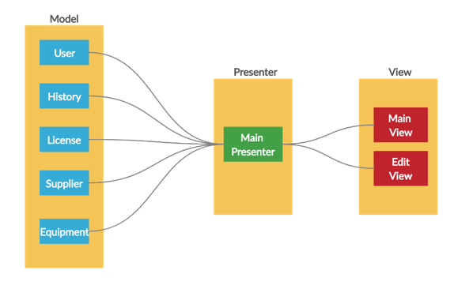
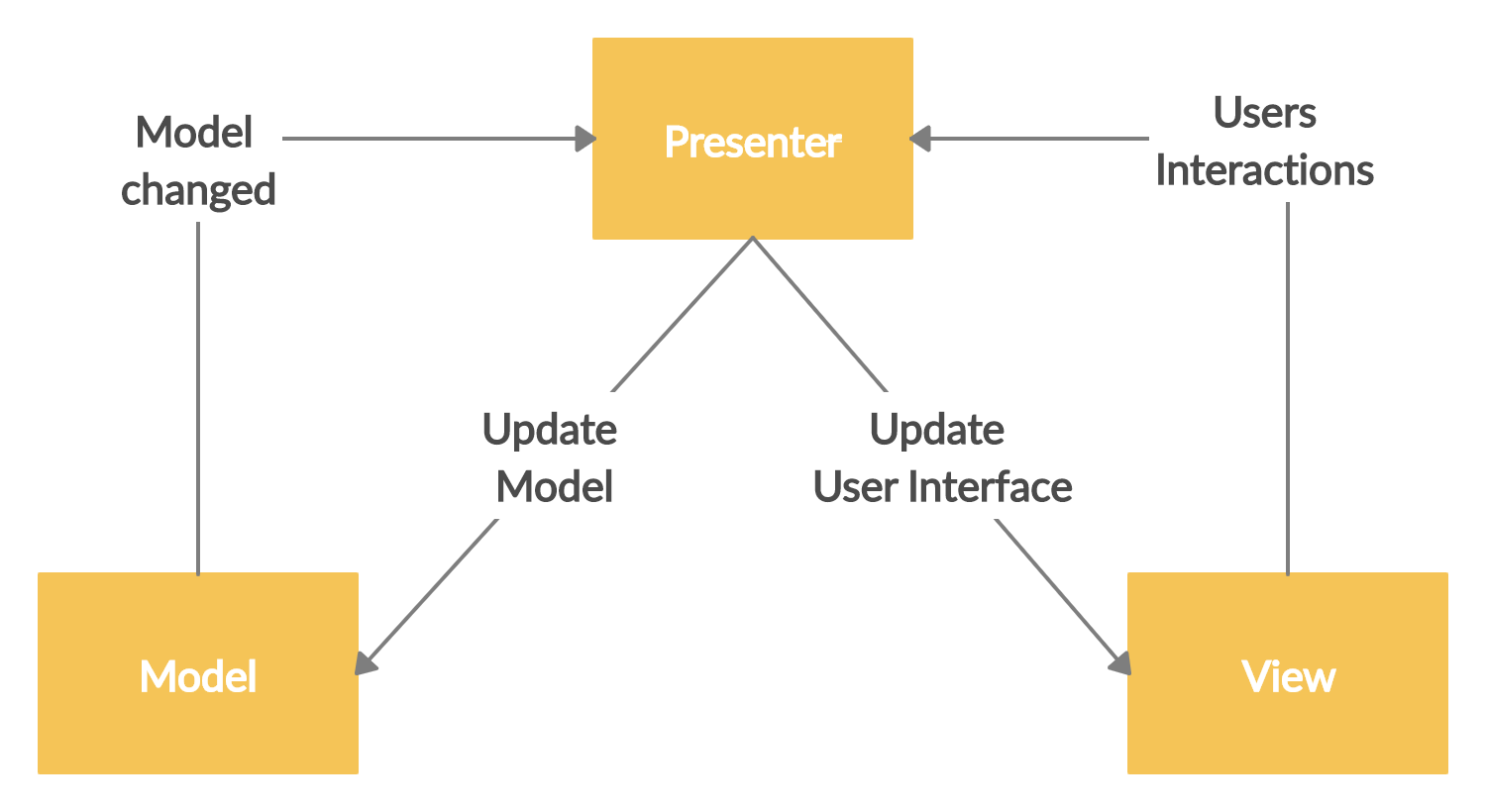
Architecture
Model view Presenter (MVP) pattern

Slide 5
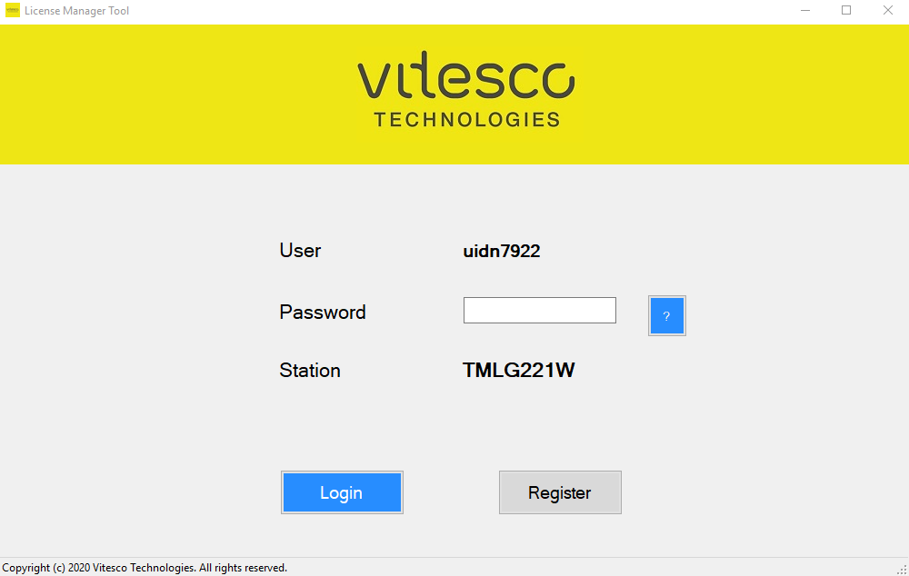
Graphical User interface – login form
Information taken automatically from the station
Forgot your password
login
register

Slide 6
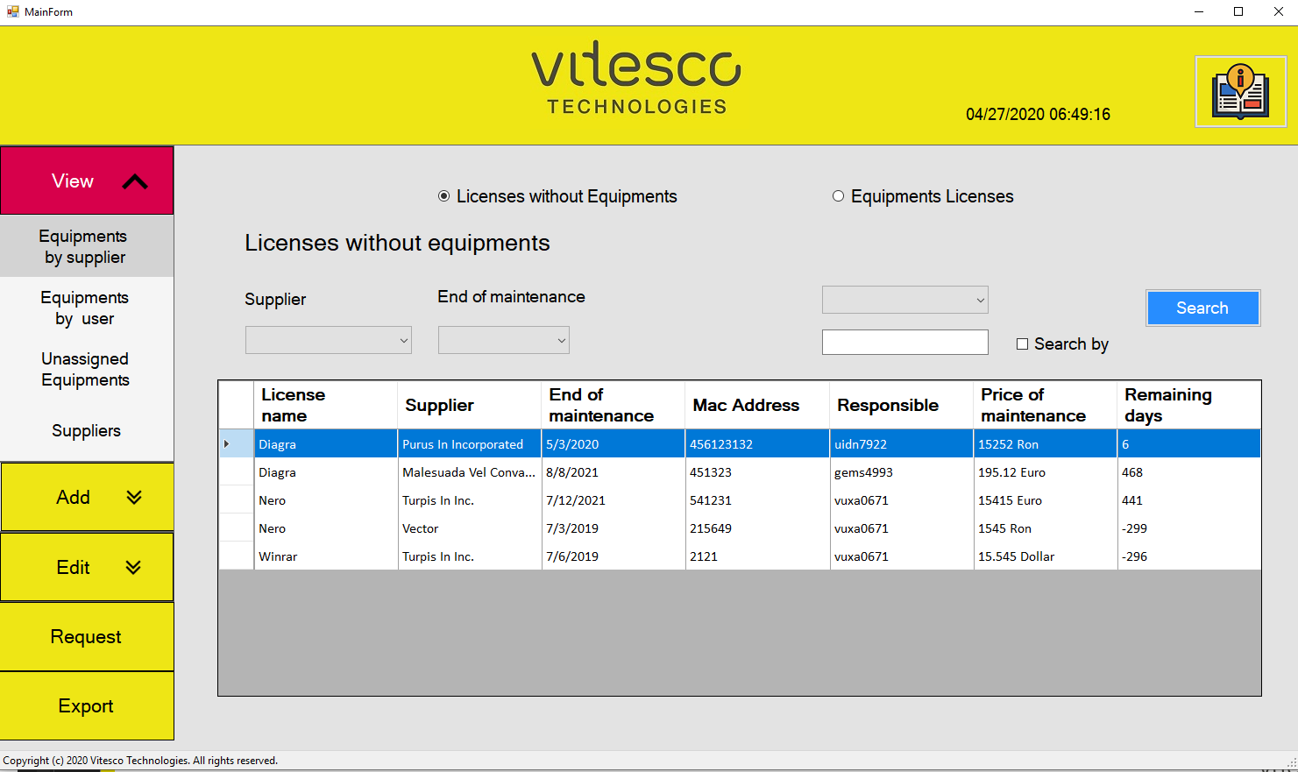
Graphical user interface – main forms
The main pages are:
View (equip/lic/supp)
Add (equip/lic/supp)
Edit (equip/lic/supp)
Delete (Equip/lic/supp)
Grant/request for rights
export
Equip = Equipment
Lic = Licenses
Supp = Suppliers

Slide 7
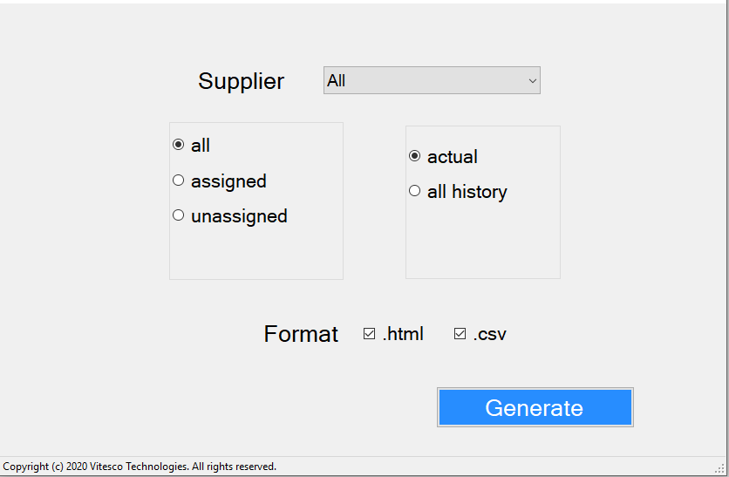
Export reports
-> The file will be created automatically by the application and stored on the user’s device and then it will open
-> The user can select the supplier, the status of equipment and licenses( assigned or unassigned), the time period etc.
-> By using this tool it is possible to generate reports in two formats (html, csv).

Slide 8


roles
there are two main roles in this tool:
Normal user
Actions:
View equip/lic/supp
Export reports
Ask for manager rights
Manager
Actions:
View equip/lic/supp
Add/edit/delete equip/lic/supp
Export reports
Grant/deny manager rights

Slide 9

Future Features
Barcode or Serial Number and Inventory Number detection via camera
Windows pop up notification
Advanced Algorithm to check if the SW licenses are used by the users or not
Various charts and graphics on exports files

